Slide 1

Afera General Assembly
Innovation and Digitization in the Adhesive Tape Technology
4 October 2018

Slide 2
MEMBERS COMPLYING WITH COMPETITION LAW
In order to protect the interests of individuals and member companies, while active within Afera (in the broadest sense), the Competition Law policy should always strictly be followed.
1) Do not discuss prices, (including price increases and pricing methods), discounts, terms of sale, the refusal to deal with another company, or profit margins with any representative of any Afera member company;
2) Do not make announcements about your prices or those of
competitors;
3) Do not talk about the plans of individual companies (yours or
competitors’) regarding specific geographic or product markets or
regarding particular customers;
4) If in doubt consult the Associations’ staff or legal counsel.

Slide 3

Afera and GDPR
A new privacy law applying to the E.U., the General Data Protection Regulation (GDPR), went into effect on 25 May 2018
Afera complies with GDPR, having signed a processing agreement with Lejeune Association Management
Afera has updated its privacy policy (afera.com/general/privacy-policy)
Nothing fundamentally changes in the way we deal with your data, but we now have clearly defined procedures
  We have made an overview of the data we collect and how we use it
  We never collect more of your data than is strictly necessary
  Your data will never be used
  for commercial interest
You have the right to view
and to modify your stored
data or to request that
certain data be deleted

Slide 5

Afera
Marketing Committee
General Report 2018
Plans 2019
By Chairman: Jacques Geijsen

Slide 6
Update from the Marketing Committee
Jacques Geijsen

Slide 7
Actioned 2018, Ongoing 2019
Marketing : Internal vs. External
External : - increase converter members
- educational program
- website / social media / mailings
Internal : content : - stimulate vs. mandate contributing content
- market study (retrospective)
- relevancy based on type of member ( tape manufacturer, converter, supplier)
annual conference 2018 (format – program)

Slide 8
Annual Conference 2018
Steering Committee
(SC)
Technical Committee
(TC)
Marketing Committee
(MKC)
Marketing Communications
Member Recruitment
Annual Conference
Educational Awareness

Slide 9

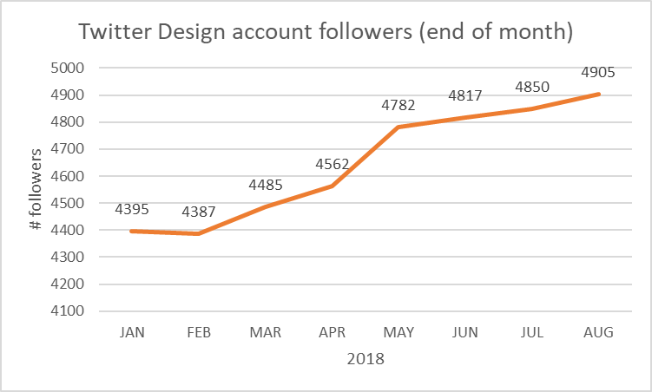
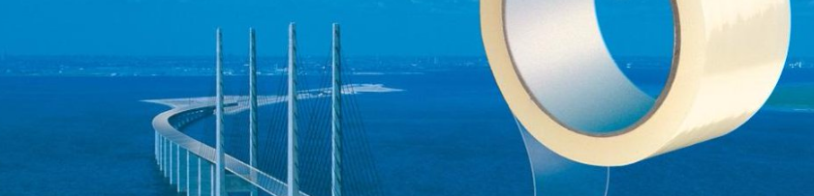
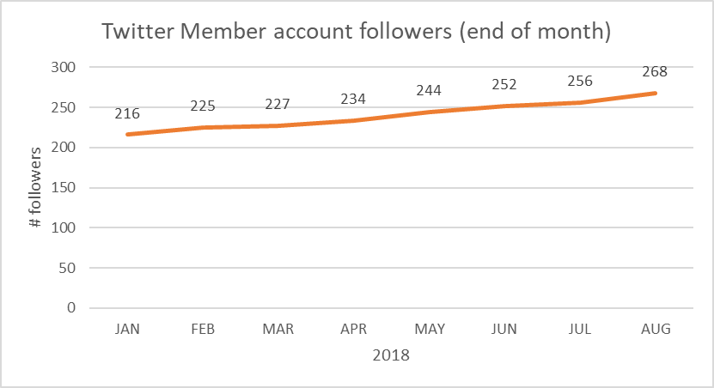
MarCom
Current # followers 4964
Current # following 5447
Likes 199
Current # followers 268
Current # following 573
Likes 12

Slide 10
MarCom
Content creation | Finalising current draft of Afera website content style guide Input from committees for content calendar Draft Afera and Why tape? presentation
Website best practice (functionality, usability, SEO, subscribes & emails, KPI’s) | Collect company introductions for ‘find a member’ page Investigate auto-creation of meta data (carried forward from Feb) Continue optimization & expanding tracking analytics Continue SEO for Why tape? section Further develop webpages (see cloud based detailed WG action plan)
Social media activities | Continue to increase visibility of Afera content through marketing integration plans EV to take over from LV end of year – transfer in November
Other | Awaiting new strategy/structure Afera (next call scheduled 30 Oct) Further build database of MARCOM contacts member companies Research: Could a feedback and discussion board be created for test method development on the Global Tape Forum website?

Slide 11

Annual Conference 2018
Most valued event
  Strong content
  Tape – Olympics

Slide 12
Tape - Olympics

Slide 13
Afera
Technical Committee
General Report 2018
Plans 2019
By outgoing Chairman Evert Smit
Next Chairman: Reinhard Storbeck

Slide 14

2018 achievements, actions forward
Working groups
  Strategy for more active participation
1st Global Adhesive Tape Summit
  Global Tape Forum Mtg
  Global Test Methods Committee Mtg
Test methods WG
Regulatory affairs WG
Education awareness initiative
Tape College: Brussels, 8-10 April 2019
Investing in professionalisation

Slide 15
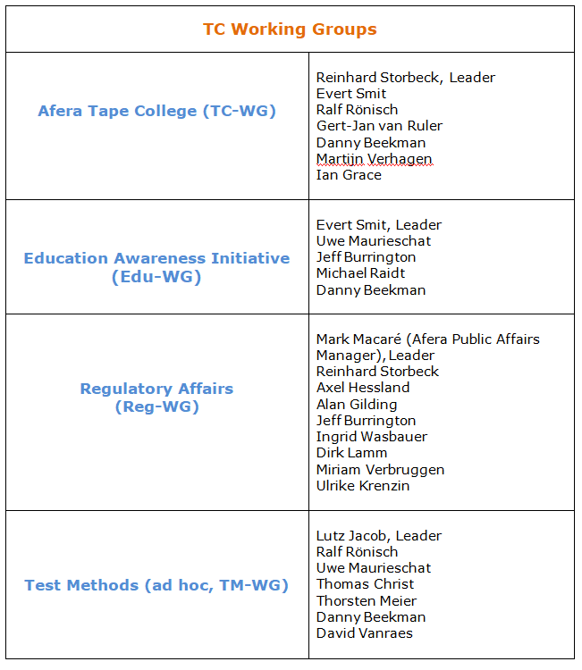
Working groups
GATS 2018

Slide 16
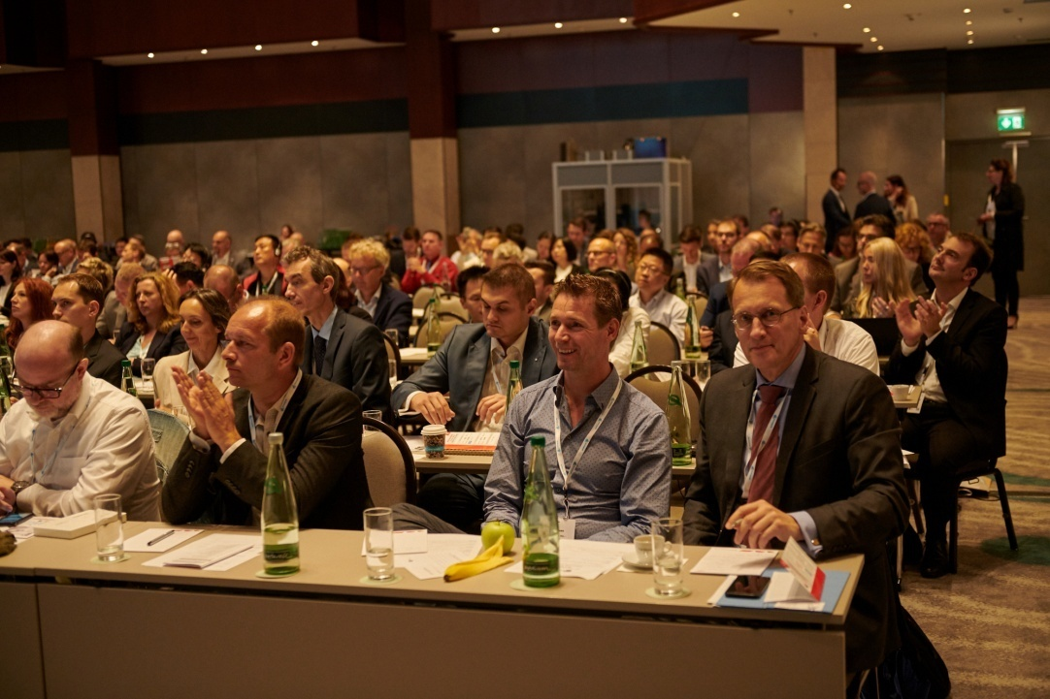
1st Global Adhesive Tape Summit
Afera’s first truly global tape event
Held 11-15 June 2018, sold-out event hosted at 2 conference hotels
Attended by 230 tape industry delegates
Next event: Osaka, Japan, 2020

Slide 17
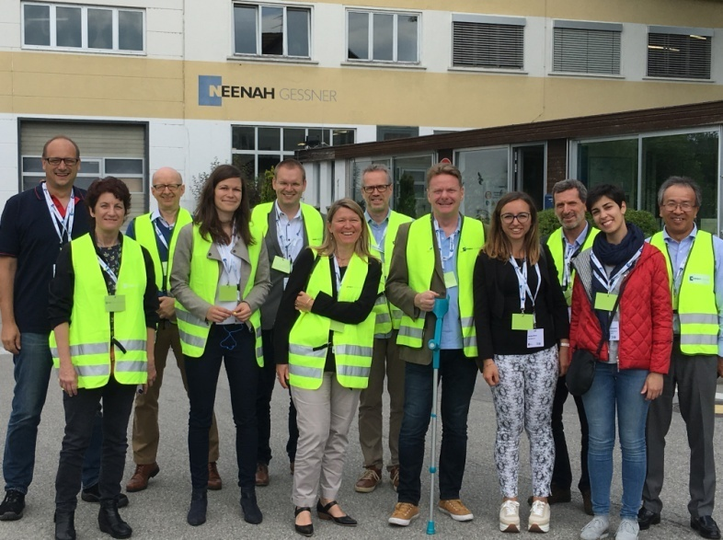
1st Global Adhesive Tape Summit
Company visit of Neenah Gessner GmbH
in Bruckmühl

Slide 18
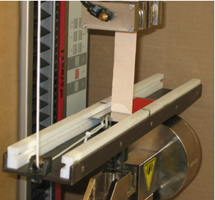
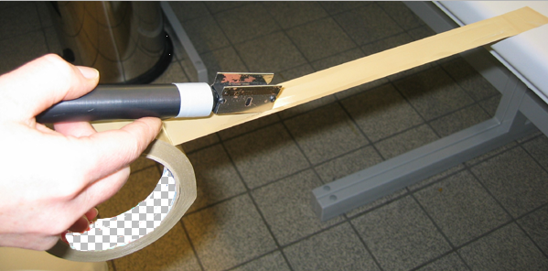
Test methods
Implementation 2019:
Loop Tack TM
Dynamic Shear/Lap Shear TM (w/PSTC)
Test Panel Cleaning Study (w/PSTC)
Methodology of Measurement Uncertainty TM (w/PSTC)
Peel Adhesion Depending on Test Plate Surface Roughness TM (w/JATMA)

Slide 19

Test method manual
Afera Test Methods Manual, 2019 ed.
                Needs to be completely revised and edited
                External consultant necessary -
                (Est. 20k Euro)

Slide 20
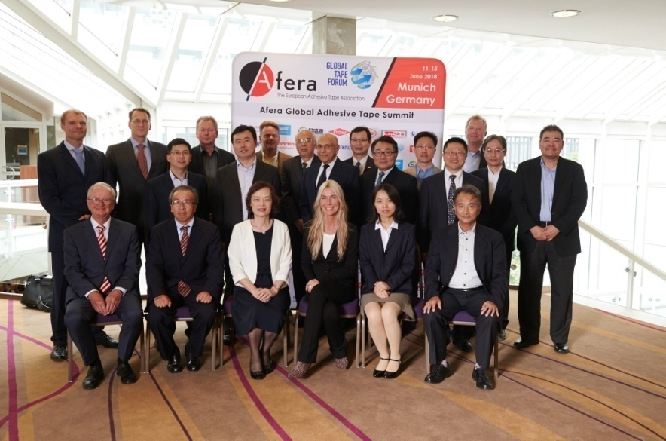
GATS - GTF & GTMC
Global Tape Forum (GTF) and Global Test Methods Committee
(GTMC) Meetings, 2 June preceding the main GATS lecture programme
Nearly 30 delegates from the national/regional adhesive tape associations of
  Europe (Afera, The European Adhesive Tape Association)
  China (CATIA, The China Adhesives and Tape Industry Association)
  Taiwan (TAAT, The Taiwan Regional Association of Adhesive Tape Manufacturers)
  North America (PSTC, The Pressure Sensitive Tape Council)
  Japan (JATMA, The Japanese Adhesive Tapes Manufacturers Association)

Slide 21
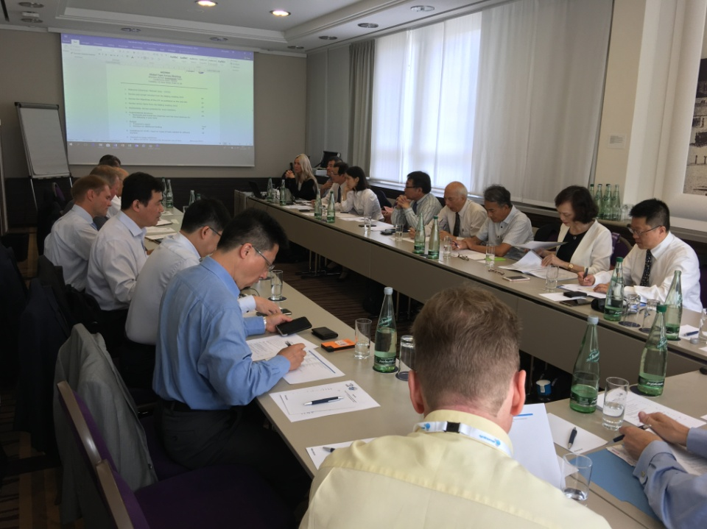
GATS - GTF & GTMC
Programme covered
  Developing and officialising TMs and guidelines
  Process to propose a TM for harmonisation (PSTC)
  Sharing market statistics and trends (will cover in more detail during tomorrow‘s GATS tech update presentation)
  Comparing environmental legisaltion and classifying of tape products
  Identifying world markets not yet organised
  Reporting on demand increase initiatives.
Next meeting: 16-19 November 2020
in Osaka, Japan, hosted by JATMA

Slide 22

Test method harmonisation
Adopted by the GTF in 2018:
GTF 6001 (SAFT)
GTF 6002 (Thickness)
GTF 6003 (Width & Length)
GTF 6004 (Peel Adhesion)*
GTF 6005 (Breaking Strength & Elongation)*
GTF 6006 (Static Shear Adhesion)*
*For all national bodies, ISO-certified TMs to retain their official ISO numbers but referred to in their manuals by their GTF numbers as well

Slide 23
Regulatory affairs
The final REACH deadline passed…
But the work is not over!
Evaluation of substances, adjustments in classification
  Recent example: classification of D4, D5 and D6 as SVHC
Need to monitor developments and status of suppliers
  Current issue: Impact of Brexit on your suppliers’ and your own status under REACH
Further increase our professional efforts
(10k Euro)

Slide 24
Regulatory affairs
BREF STS
Draft 1 of new BREF document released October 2017
  Urgent Afera comments:
    mistakes in solvent consumption values
    unrealistic NO_{x} and CO₂ emission limit ranges
    Other...
  Comments discussed in May, Afera position supported by Germany & other industry.
  New draft expected mid October
  Final meeting 10-14 December – last chance for comments
    Afera TC members will participate

Slide 25

Education awareness initiative
  Engage tomorrow’s engineers and designers
    Awareness of tape technologies
    Get tapes into curricula of European mechanical engineering and product design higher education programmes
  Pilot project UK with Pearson, follow-up in Q1 2019
    Developing adhesive tape bonding content and hands-on support material for 2021
  Localize content for rest Europe – invest est. 10k Euro

Slide 26
Afera
Steering Committee
General Report 2018/
Plans 2019
By President:
Mete Konuralp

Slide 27

Members
Active: 42
Associated: 45
Converter: 12
Affiliated: 4
Total: 103
New: 11
Exited: 3

Slide 28
Financial Report
Balance Sheet 2018
Budget & Latest Estimate 2018
Budget 2019

Slide 29
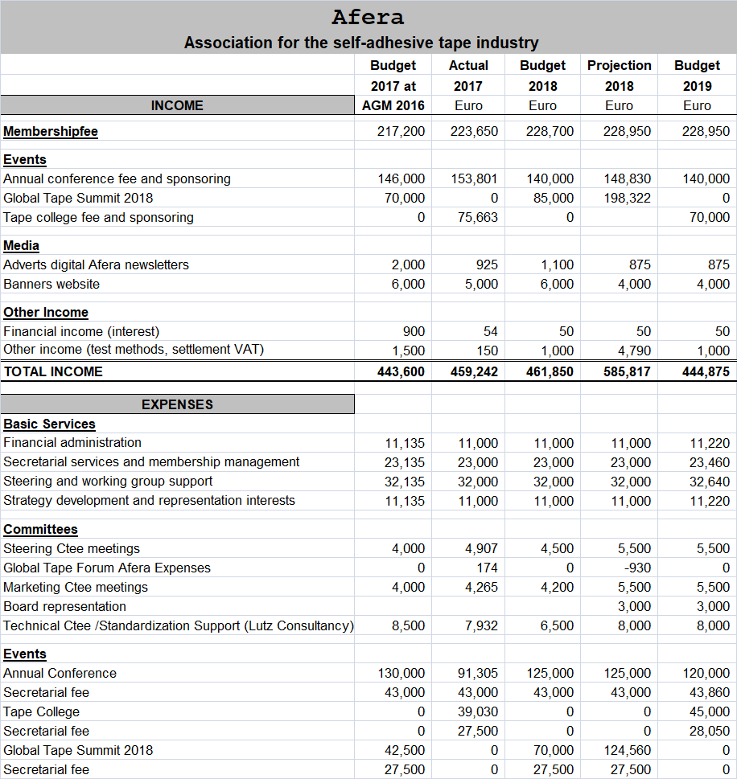

Slide 30
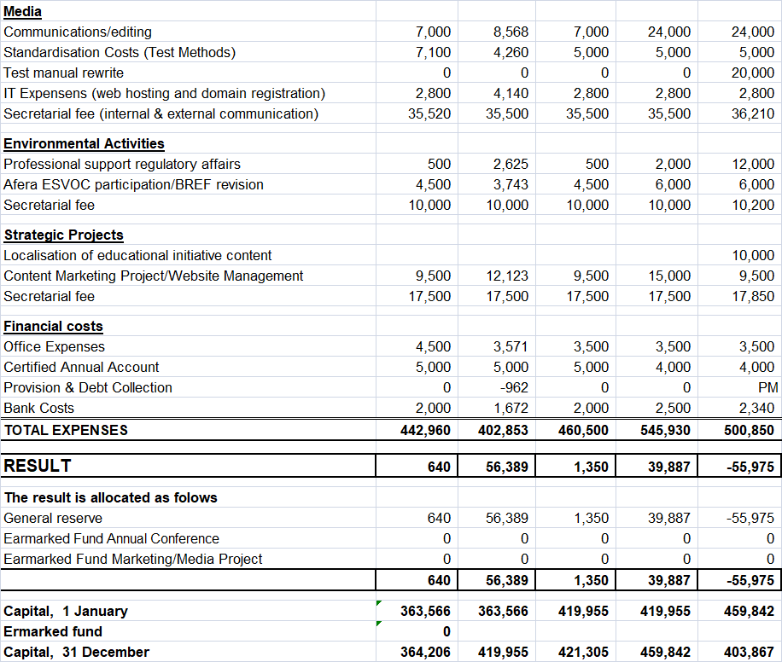

Slide 31
Membership Fees
Due to Afera’s effective strategic direction resulting in a strong financial position, our membership fees will not be changed for 2019

Slide 32

Events in 2019

Slide 33
AFERA Management
SC
MKC
TC

Slide 34
New Composition Steering Committee
Representing Company Candidates Until__
Tape Manufacturer Lohmann Evert Smit 9/2021
Tape Manufacturer 3M Lori Cherry 9/2020
Tape Manufacturer tesa Reinhard Storbeck (TC Chair) 9/2021
Tape Manufacturer American Biltrite Jacques Geijsen (MKC Chair) 9/2020
Tape Manufacturer TBD TBD 9/2021
Converter Egebant İbrahim Hatipoglu 9/2021
Supplier Bostik Ian Grace 9/2020
Supplier HB Fuller Melanie Lack 9/2020
Rotation Schedule:
Presidency Years Vice Presidency_____
Evert Smit 2018-2021 Lori Cherry

Slide 35
Official Opening
61st Annual Conference

